Slide 1



Slide 2

Meet the Team
Ben McMellan – Chief Executive Officer
Abi Hay – Head of Business Development and Sporting
Adrian Coppin – Head of Events and Commercial Operations
Matleena Pukklia – Series Manager
Tom Collings – Marketing and Partnerships Manager
Michael Stratus – SpeedSeries Media Manager
Imarni Paynter Davis – Team Relations Assistant
Belinda Taylor – Sporting Coordinator
Steve Chopping AM – Series Steward
James Taylor – Race Director
Craig Baird – Driving Standards Advisor
Nigel Faull – Deputy Race Director
Jacqueline Devereaux – Assistant Race Director
Scott McGrath – Technical Manager and Pit Lane Manager
Geoff Riddle – Technical Delegate
Ashley Sheffield – Deputy Technical Delegate

Slide 3

Where they are Located
SRO Office -(as per Paddock diagram):
Ben McMellan
Abi Hay
Adrian Coppin
Matleena Pukklia
Irmani Paytner Davis
Stewards Office
(as per Paddock diagram):
Steve Chopping
Belinda Taylor
Site office (as per Paddock diagram):
James Taylor
Craig Baird
Nigel Faull
Jacqueline Devereaux
Technical Bays (as per Paddock diagram):
Scott McGrath
Geoff Riddle
Ashley Sheffield

Slide 4
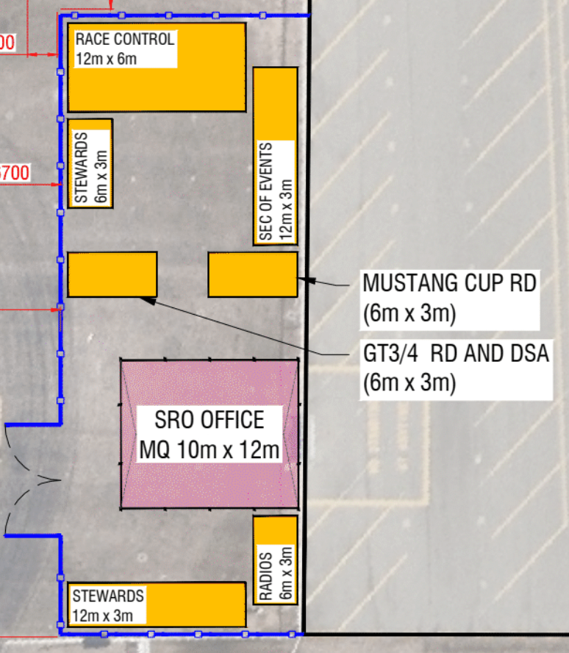
Where the offices are Located

Slide 5
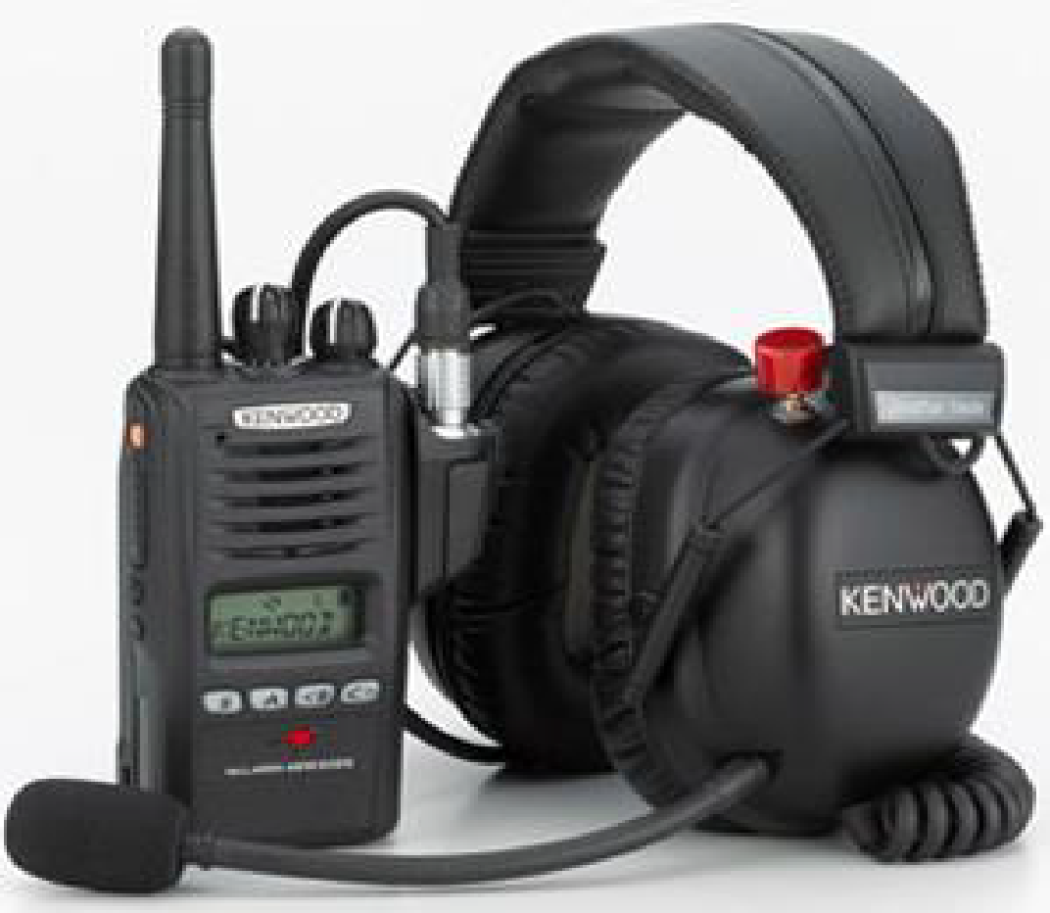

Race Management Channel (RMC)
TEST 15 to 20 minutes before each session
First session of the day answer ”ok” + car # on the SRO team messaging
Time check 10 to 15 minutes before the first session each day
For a test or an issue contact Scott McGrath

Slide 6
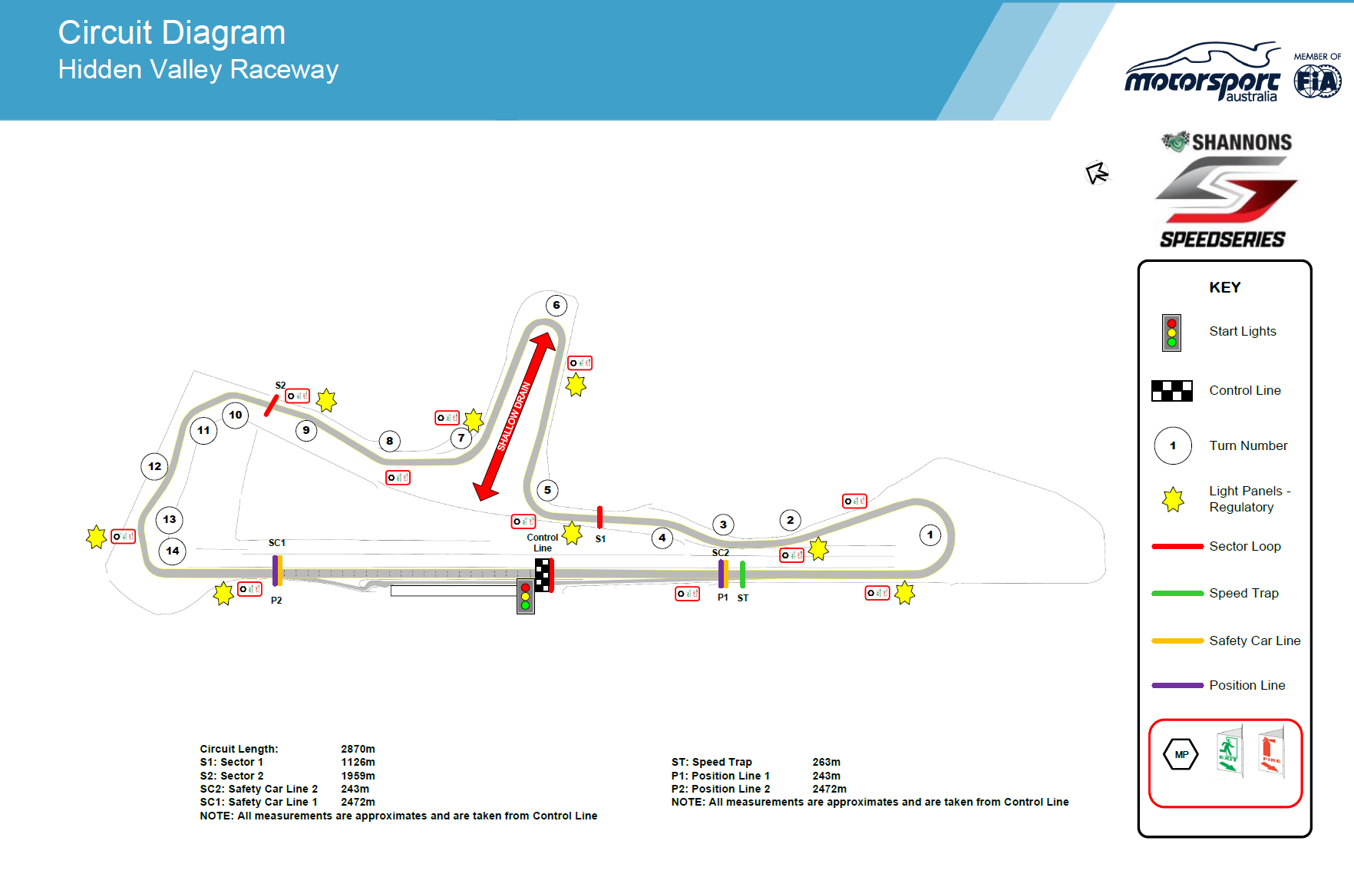
Circuit Diagram

Slide 7

Light Panels and Flag Posts
Trackside Light Panels and or Flag signals will be operational for this round.
The Light Panel locations are displayed on the Circuit diagram as ( )
Any signal displayed by a Trackside Light Panel or Flag Signal will be regulatory and must be complied with.
Failure to obey any Trackside Light Panel or Flag signal will be referred to the Stewards.
Trackside Light Panels and or Flag signals will be operational for this round.
The Light Panel locations are displayed on the Circuit diagram as ( )
Any signal displayed by a Trackside Light Panel or Flag Signal will be regulatory and must be complied with.
Failure to obey any Trackside Light Panel or Flag signal will be referred to the Stewards.

Slide 8
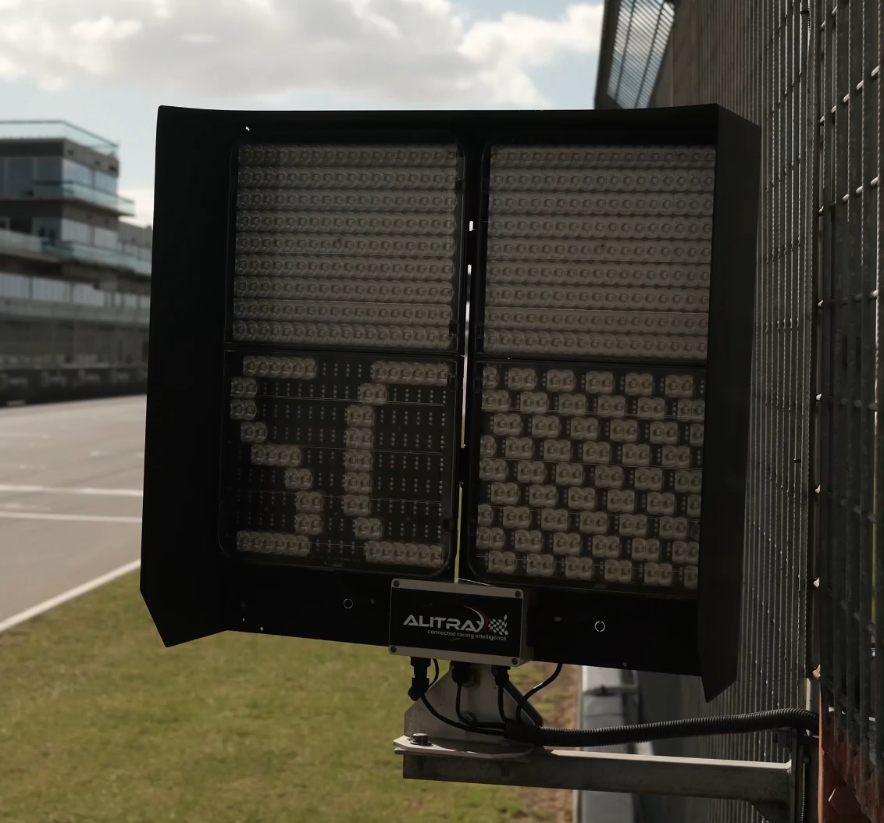
Light Panel Signals

Slide 9
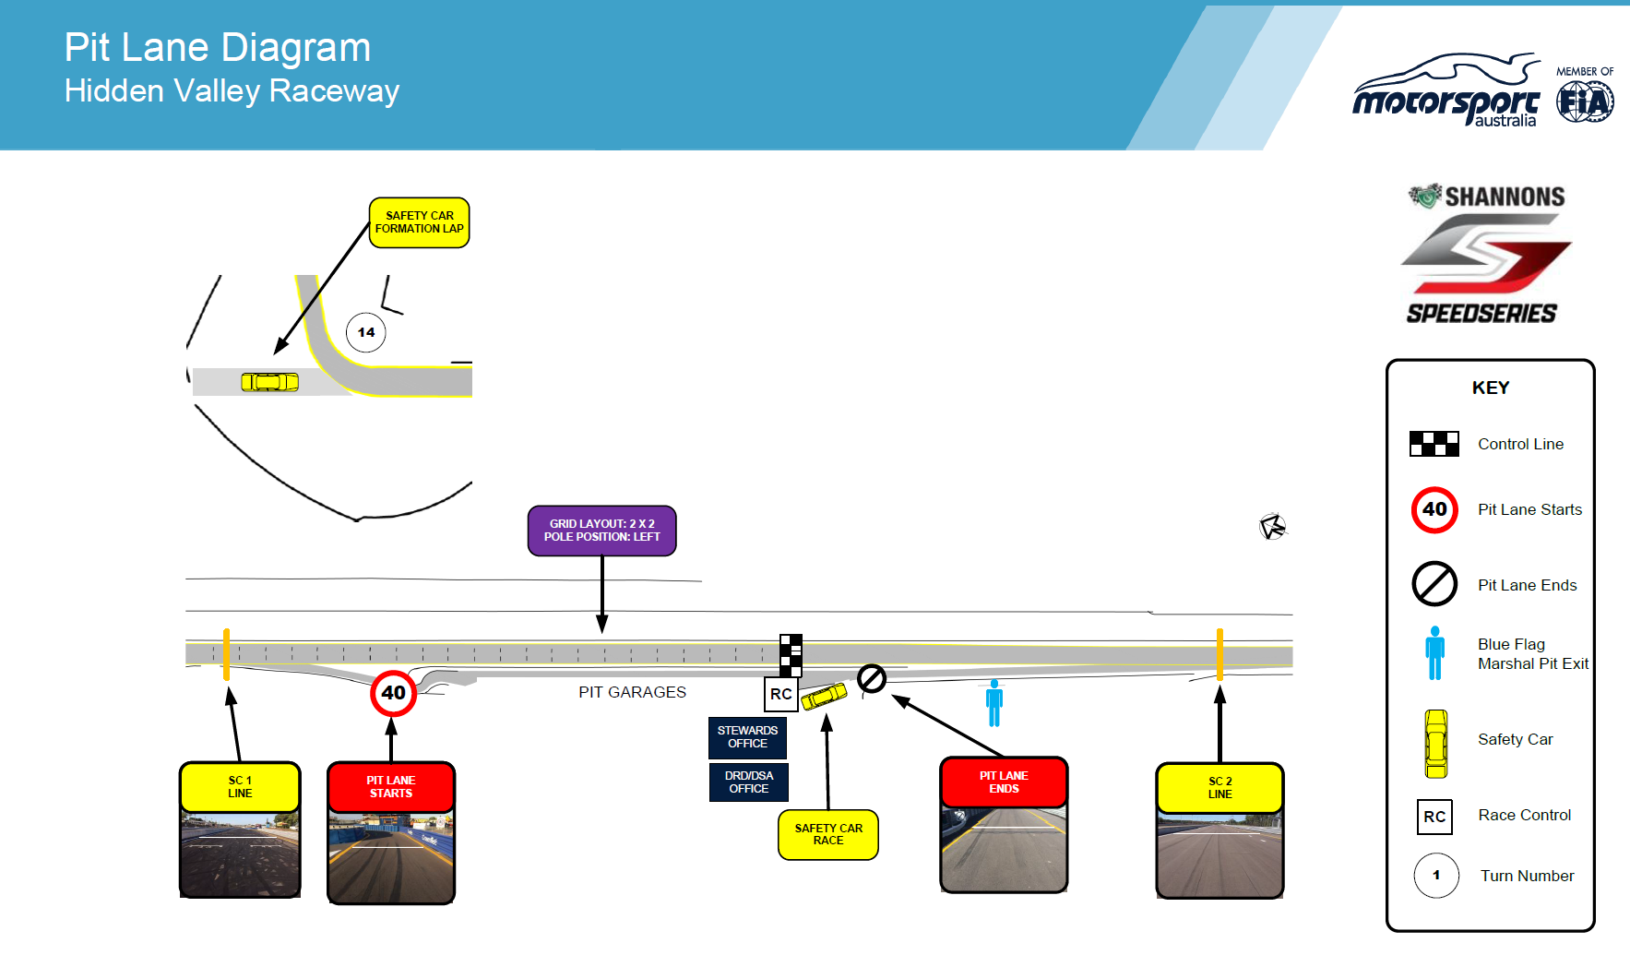
Pit Lane Diagram

Slide 10
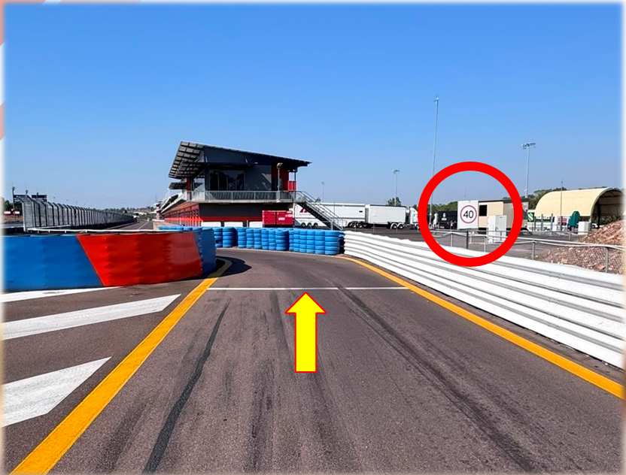
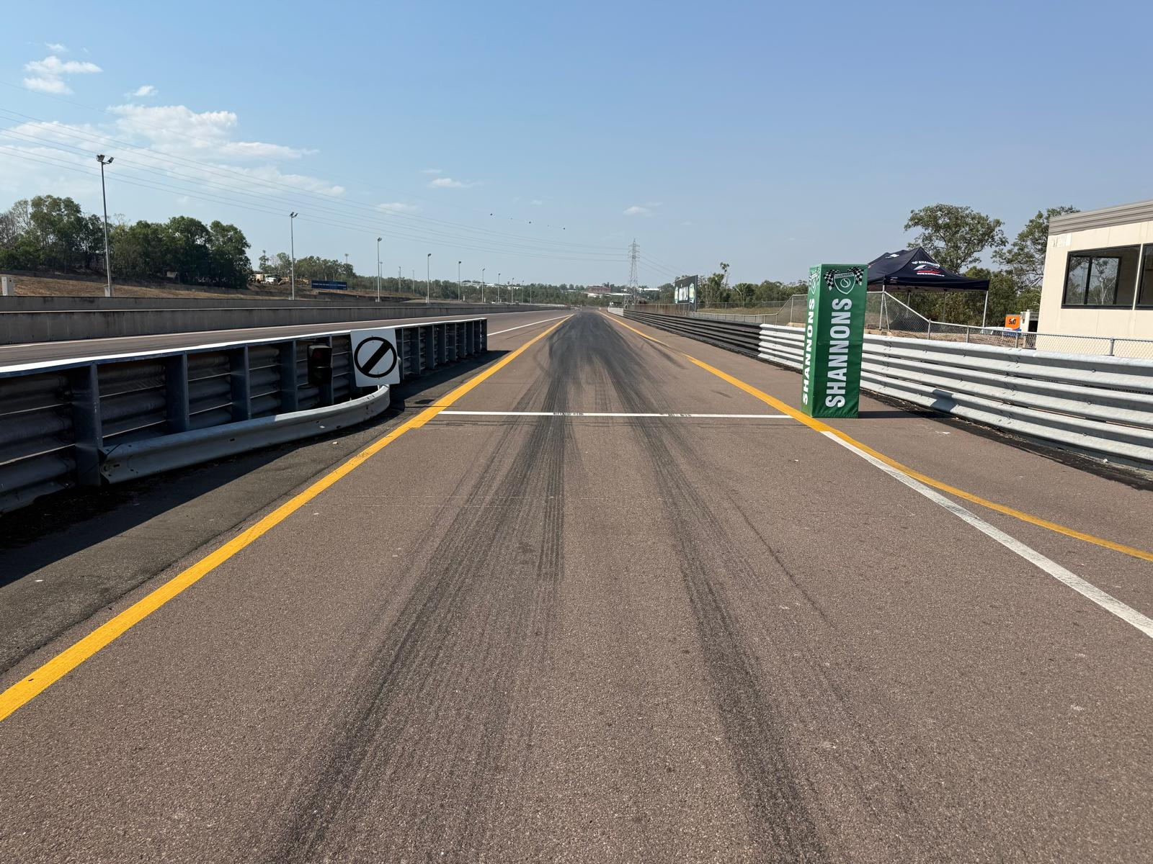
Pit Entry and Exit

Slide 11
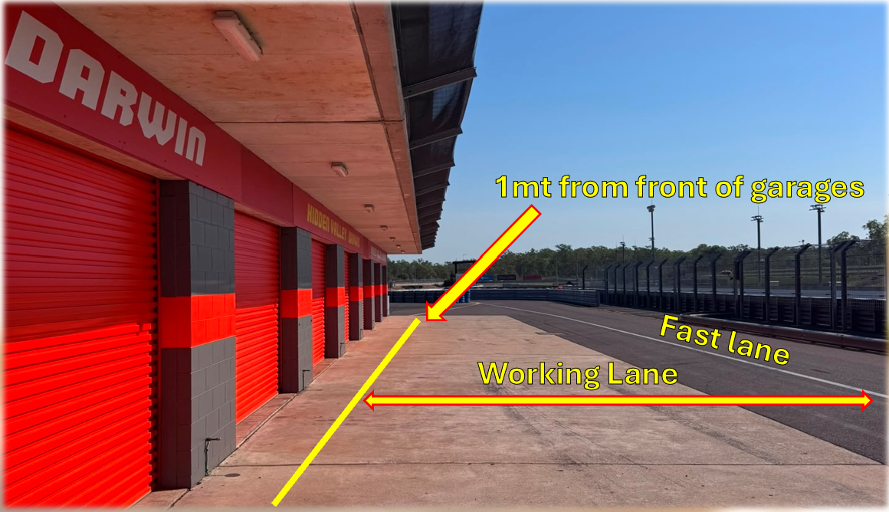
Pit lane

Slide 12
Start of Sessions
All Cars to follow the route as per the Paddock movement plan to the Marshalling area
Cars will be called in order to proceed to the Marshalling area via RMC.
No Cars are to proceed from the marquee until announced on RMC.
Cars will proceed to Pit Exit in order from the Marshalling area once announced on RMC or by a message on the SRO Teams App.

Slide 13
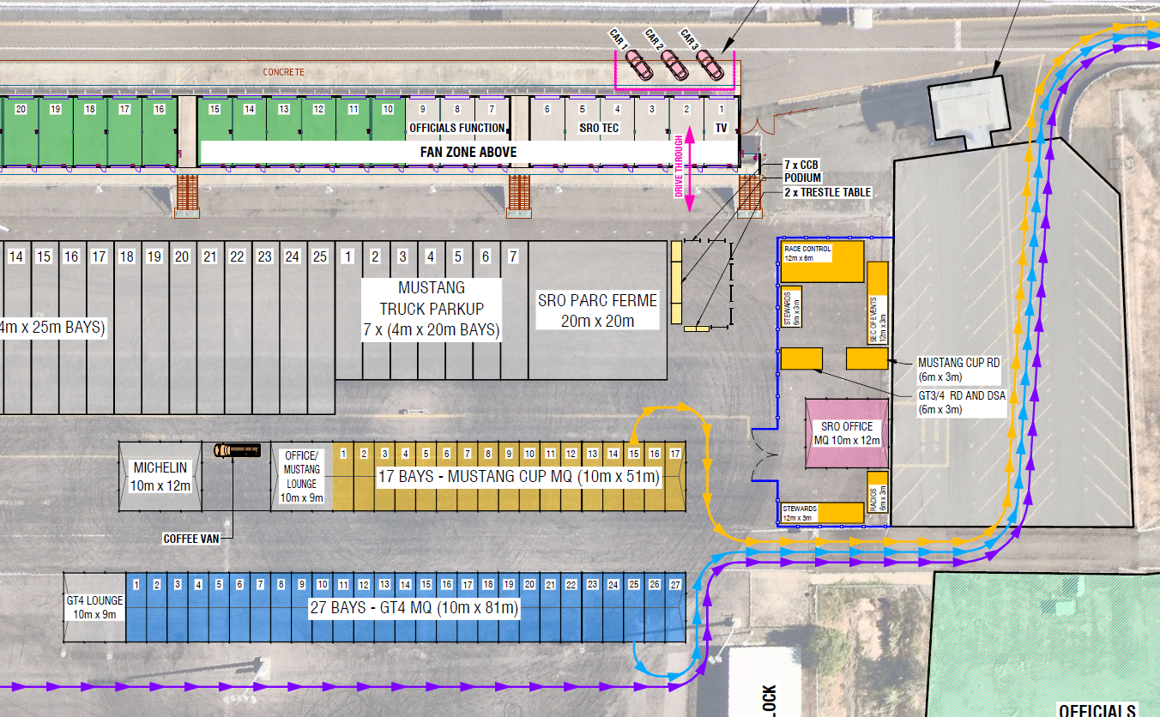
Paddock to the Circuit

Slide 14
Pit Stop protocol
Car Control
No personnel may hold panels on the working lane or stand behind stationary panels.
No lollipops or panels may be fixed or shown from the pit wall towards the pit lane.
Team personnel may use lollipops to indicate to the cars from the working zone.
(Article 36.4 in Pit Stops – General)
No Car can be driven directly IN or OUT of a garage .
If the need arises that you need to return to your garage during a session, the Car must first stop parallel in your allocated pit area.
The Car must be then placed on SKATES and pushed back into your garage.
The Car must be pushed on SKATES to the parallel position. Once safe to do so the car may be released.

Slide 15
Pit Stop protocol
Practice Sessions
All cars to stop parallel at their allocated pit bay area.
If a RED Flag is called during a session, then all Cars must be at 45° nose out ready for a possible resumption to the session.
Qualifying
All cars to stop parallel at their allocated pit bay area.
If a RED Flag is called during a session, then all Cars must be at 45° nose out ready for a possible resumption to the session.
Races
All cars to stop parallel at their allocated pit bay area.
At all times the following must be adhered to;
Each car must have a car controller managing the safe release of the car.
The car controller must be wearing the white armband.
All crew members to be appropriately attired and arm bands must be worn.

Slide 16
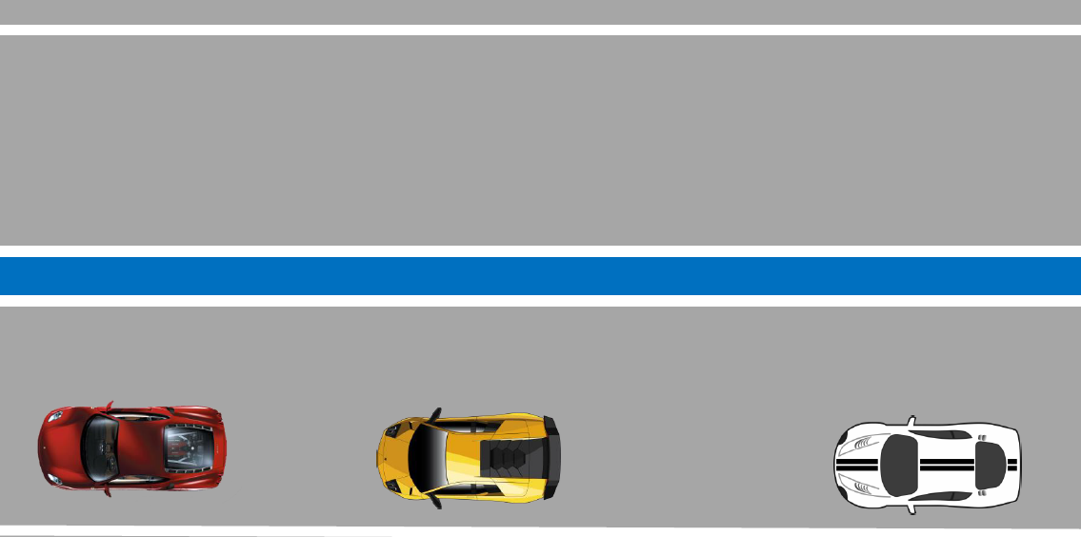
Pit Lane protocol
Direction of travel

Slide 17
End of Sessions
All Cars to complete a full “COOL DOWN” lap and to return to Pit Lane.
All Cars are to follow the route as per the Paddock movement plan, from Circuit to the Paddock.

Slide 18
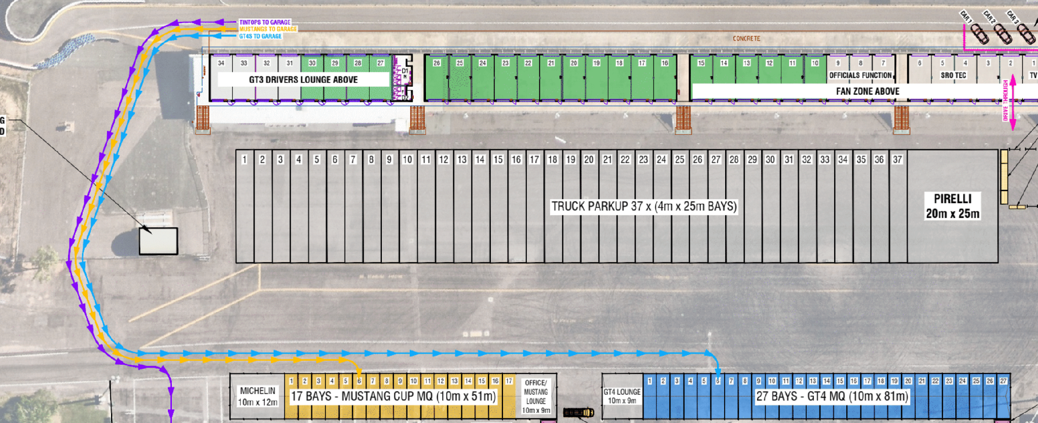
Circuit to the Paddock

Slide 19
Qualifying 1 to Qualifying 2
All Cars to stop in their allocated Pit Bay area in Pit Lane at the end of Qualifying 1.
All Cars are under Parc Fermé conditions from when the Chequered flag is displayed.
All Cars will be released from Parc Fermé conditions by direction on RMC or by message on the SRO App to prepare for Qualifying 2.
Cars can not proceed to Pit Exit until FAST LANE has been announced on RMC or by message on the SRO App for the commencement for Qualifying 2.

Slide 20
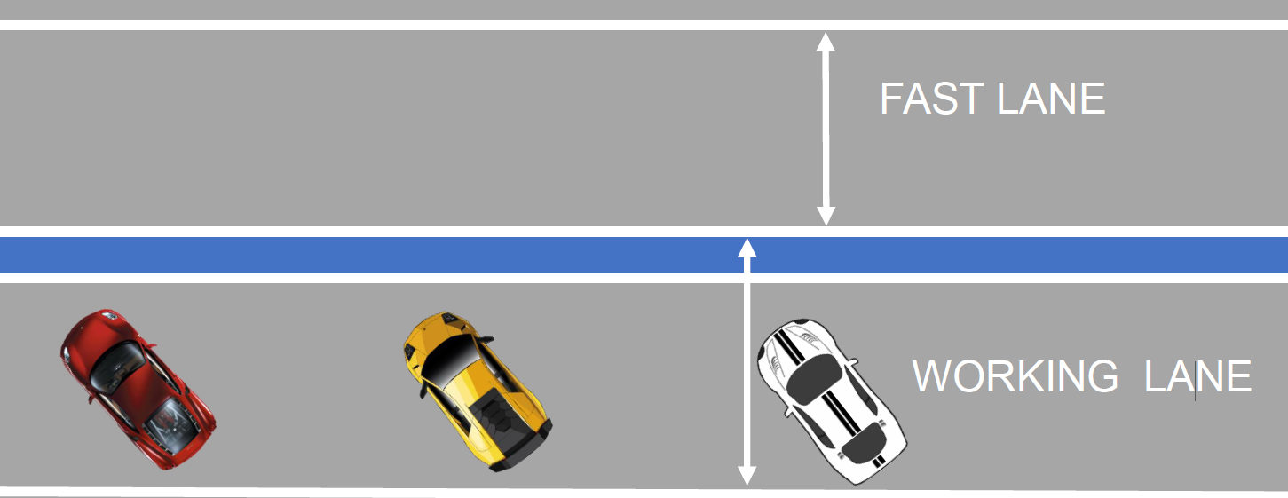
Pit lane protocol,
Red Flag and start of Qual 2
FAST LANE
Direction of travel
WORKING LANE

Slide 21
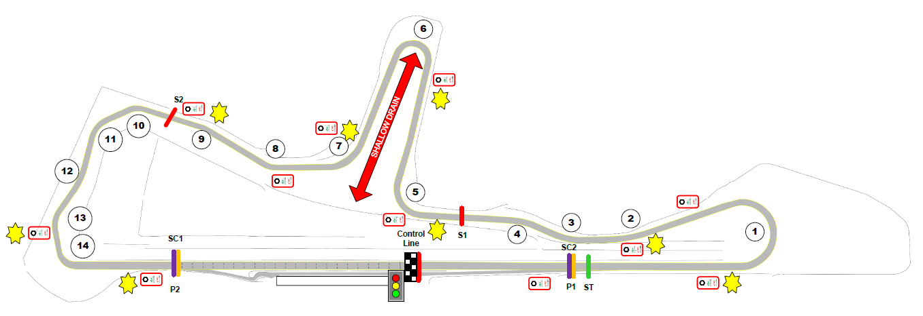
Race Start
Side x Side form up location Turn 12 (Article 45.5)
Competitors to commence SIDE x SIDE formation from Turn 12
Note:
Race Control 1 (Lead Car) will reduce speed to 50 Kph when lights are extinguished at Turn 7.

Slide 22
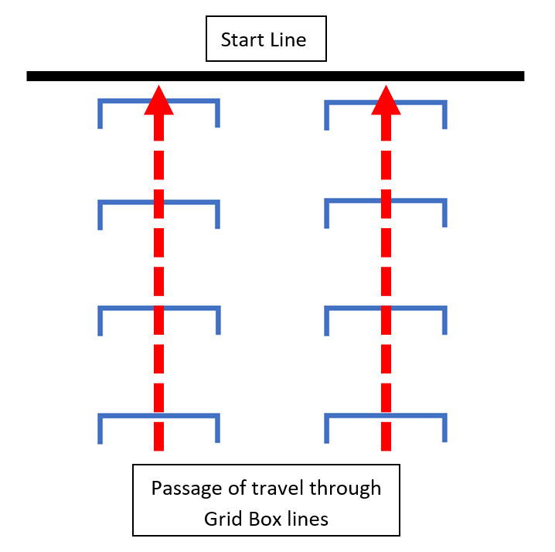
Race Start
Proceed through the Grid Boxes
All Cars on POLE position side Drivers Left to pass through the grid boxes on this side
All Cars on 2nd position side Drivers Right to pass through the grid boxes on this side

Slide 23
Race Start Procedure
The field will be led by Race Control 1 (Lead Car) at the commencement of the Formation Lap.
When Race Control 1 exits Turn 7, it will reduce speed to 50 Kph. This is to bunch the field, at this point Race Control 1 will extinguish the roof lights.
As the field approaches Turn 12, the field should commence Side x Side formation.
Race Control 1 will continue to lead the field until it reaches the Pit Entry road, at this point Race Control 1 will return to Pit Lane.
From the point that Race Control 1 has entered the Pit Lane entry road, the Pole Car controls the speed and may only accelerate to the maximum speed as per the 2026 Sporting Regulations.
All cars are to travel through the Grid boxes on their respective side of the circuit. Until the RED Start lights have been extinguished, the RED lights being extinguished signals the race has started.
If the Start lights remain ON, this is the signal that the Start has been ABORTED – Extra Formation Lap.
Yellow flags will be shown at all Marshal Posts, and the Pole Car is now responsible to reduce speed to 80 Kph and lead the field.
The field is to recommence the Side x Side formation from Turn 12 and travel through the Grid boxes on their respective sides of the circuit until the RED Start lights have been switched off.

Slide 24
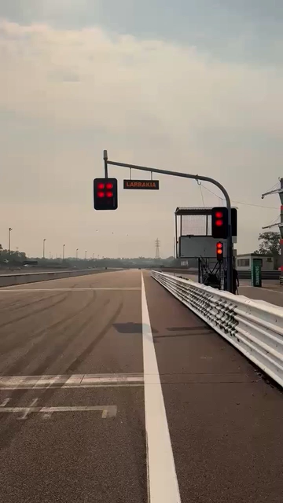
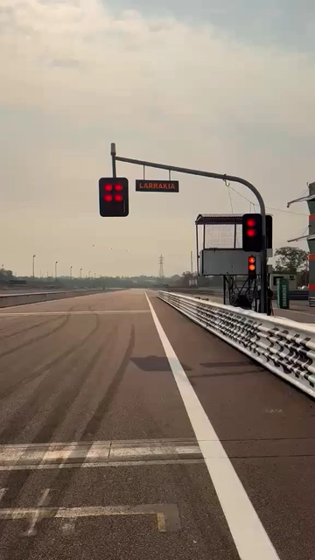
Start Lights

Slide 25
Track Limits
Turn 5 runoff Drivers Left
If you run wide at Turn 5, you must rejoin safely prior to Turn 6.
If you rejoin via an alternative route, the incident will be referred to the Stewards.
Practice
Drivers will be warned and if necessary, displayed the Bad Sportsmanship Flag.
Excessive breaches may result in incidents being referred to the Stewards, a penalty maybe applied.
Qualifying
A Judge of Fact decision will result in the lap in which the breach occurred, being deleted.
Excessive breaches may result in incidents being referred to the Stewards, a penalty maybe applied.
Races
1st Notification - A Bad Sportsmanship Flag will be displayed to the offending Car.
Continual Breaches - Offending Car will be referred to the Stewards, a penalty maybe applied.

Slide 26
Impeding
Practice
Drivers will be warned and if necessary, displayed the Bad Sportsmanship Flag.
Excessive breaches may result in incidents being referred to the Stewards, a penalty maybe applied.
Qualifying
Breaches may result in incidents being referred to the Stewards, a penalty maybe applied.
Races
Breaches may result in incidents being referred to the Stewards, a penalty maybe applied.

Slide 27
Safety Car Procedure
Reduce speed and do not overtake when the yellow flags and SC boards are displayed at each flag post.
Do not pass the Safety Car unless directed by the Safety Car observer – via a green light on the roof.
On each lap of the Safety Car, the pit exit will close as the Safety Car passes Safety Car Line 1 (SC 1) and will open as the last car in the formed line has passed Safety Car Line (SCL 2).
When the Safety Car lights are extinguished, it will accelerate away from the field and return to pit lane on that lap.
The nominated point to extinguish the Safety Car lights will be at Turn 7 and the SC Boards only will be removed.
When the Safety Car lights are extinguished, all cars must maintain the speed of the Safety Car (before it accelerated away approx. 80 kph) and cease the practice of aggressively accelerating and or braking and weaving until the green flag have been displayed.
When the Safety Car enters pit lane, a green flag will be displayed at the Control Line only and the lead car can then maintain speed or accelerate (they cannot reduce speed), towards the Control line.
Overtaking is prohibited until the car has passed the control line.

Slide 28
Red Flag Procedure
Practice or Qualifying
Reduce speed to 80 Kph and proceed directly back to pit lane in a safe manner.
The timing system will not be stopped.
All cars are to park parallel at their allocated pit area and be 45° for restart.
No car can leave their respective pit area until an announcement has been made via the RMC that the FAST LANE is open, and the session has resumed.
Once FAST LANE open has been announced Cars may proceed to Pit Exit in order starting from the car closest to the Pit Exit. Start of session rules apply re-car controller.
Every effort will be made to restart practice or qualifying if time permits
Races
Reduce speed to 80 Kph and prepare to stop at Safety Car Line 1 (SC 1) or as directed, or follow the SC, or follow directions given over RMC in a safe manner.
The timing system will not be stopped.
If time permits the Race will be resumed complying with Article 47.3 of the Sporting Regulations.

Slide 29
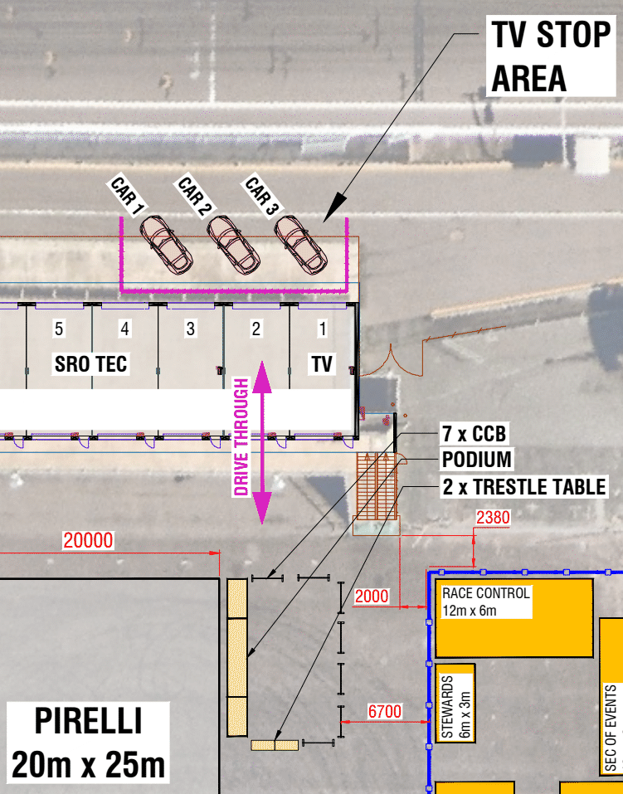
TV Stop Area & Podium
The winner of each class will be required at the stop area. They must go directly to the stop area.
If there is a second driver, they must meet the winning car at the stop area.
The podium will begin immediately after the race. Please ensure your drivers are brought straight to the podium area.

Slide 30
PARC Fermè
Qualifying
Cars required to attend the Scrutineering Bay will be announced via RMC and or the SRO App and should go straight to Parc Ferme.
All other Cars are to proceed back to the Paddock under PARC Fermè conditions.
Races
Cars required to attend the Scrutineering Bay will be announced via RMC and or the SRO App and must transit directly to the Scrutineering Bay (if not required at the stop area).
All other Cars are to proceed back to the Paddock under PARC Fermè conditions.
A mechanic with a red armband MUST remain with cars in the TV stop area. They will be required to move the cars to the Scrutineering Bay on instructions from the Technical Delegates. Failure to have a mechanic with a red armband at the stop area will be reported to the Stewards.

Slide 31
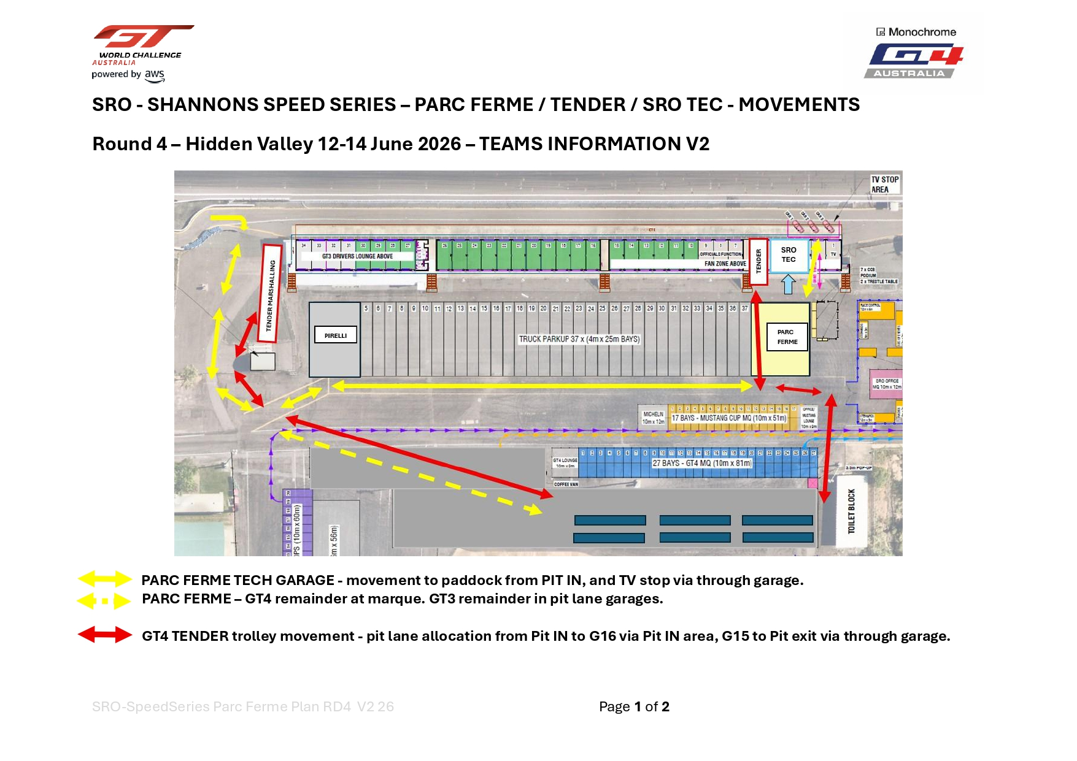

Slide 32
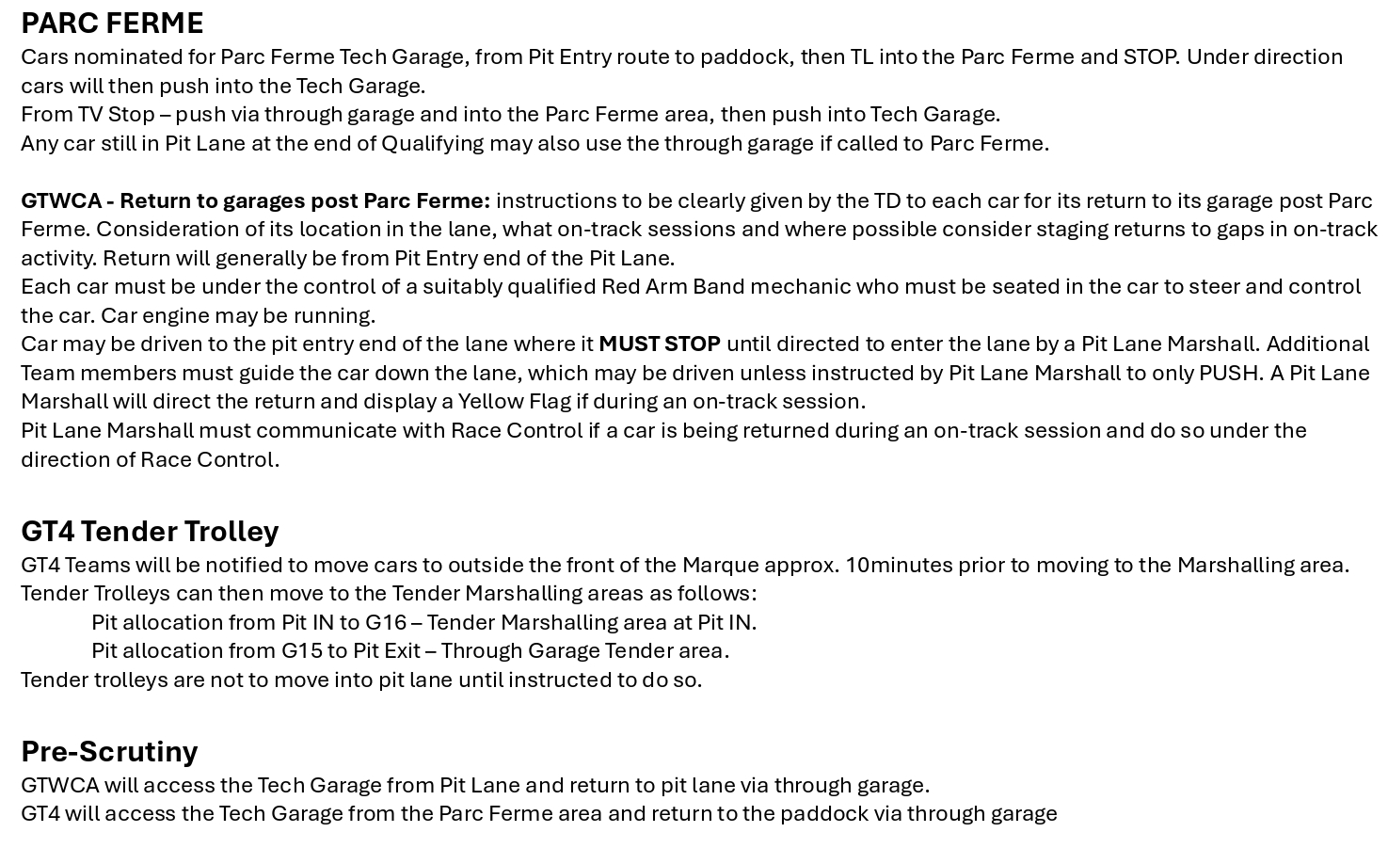

Slide 33
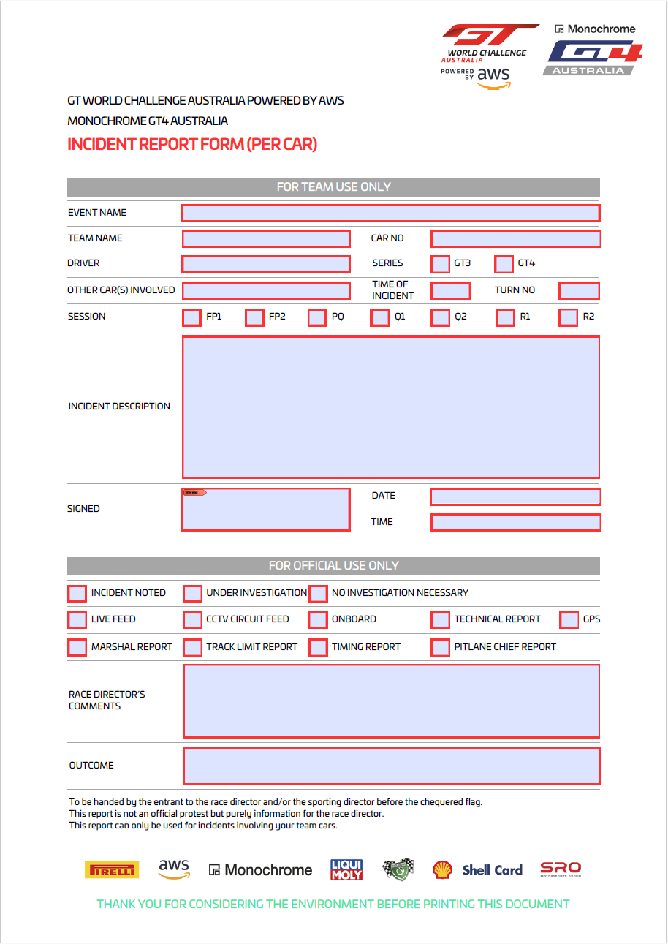
Incident Request Form
This form can be found on the website in the Teams Section under the Sporting Documents folder.
Forms must be fully completed and with relevant information. Failure to do so will result in no further action being taken.
Please note that only requests involving your Car will be accepted.
Ensure the forms are submitted by the time stated on the bottom of the form.
All forms are to be submitted via the SRO App

Slide 34




The SRO App
Directives from Race Control may appear on the APP during a session.
Each team must have one member monitoring the App at all times.
Information as required during the round will be placed on the APP.
The session completion time will be announced on the App, to ensure transparency as to when the 30 minutes timing has commenced from.
Any messages deemed to be inappropriate will be referred to the Stewards.

Slide 35
The Officials Thank you BBQ
This will be on Saturday evening from 5:15pm in Pit Lane Garages 7, 8 and 9.
Attendance is not compulsory, we are only requesting 5 to 10 minutes of your time.
To pass on appreciation to the officials that are volunteering their own time and doing this at their own expense.

Slide 36
We hope this allows you to race hard but fair, please remember to enjoy the competition and respect the Officials .
If you have any queries, please do not hesitate to approach any of the Motorsport Australia or SRO Team.

